Slide 1
DWDM Network Planning Tool
(Training-Level Feasibility Analyzer using FastAPI & React)
Presented by : Girish CK
Technology Stack : Python (FastAPI) React (Frontend UI)
Date : 23/02/2026

Slide 2
Agenda
Introduction to DWDM
Planning Metrics
Power Budget & Rx Power
OSNR (Threshold & Margin)
System Design (FastAPI + React)
API Contract
UI Screens
Edge Cases
Lessons Learned & Future Work
Live Demo & Q&A
References

Slide 3
Introduction to DWDM
These are the fundamental concepts required to understand DWDM network planning:
• Wavelengths
○ DWDM carries multiple optical channels over a single fiber
○ Each channel operates at a different wavelength (λ)
○ Enables high-capacity transmission
• Spans
○ A span is the fiber segment between two optical elements
○ Signal power reduces over distance due to attenuation
○ May include connectors, splices, and amplifiers
• ROADMs (Reconfigurable Optical Add-Drop Multiplexers)
○ Allow dynamic routing of wavelengths
○ Enable flexible optical network design

Slide 4
Planning Metrics
Fiber Attenuation
○ Signal loss per kilometer (dB/km)
○ Increases with distance
○ Primary contributor to total link loss
• Connectors
○ Each connector introduces insertion loss
○ Accumulates across the link
• Splices
○ Fusion or mechanical joints in fiber
○ Add small but cumulative loss
• EDFA (Erbium-Doped Fiber Amplifier)
○ Compensates for fiber loss by amplifying signal power
○ Includes gain and practical penalties

Slide 5
Power Budget & Rx Power
• Power Budget & Rx Power (Formula + Example)
• What is Power Budget?
○ Power Budget = Tx Power − Receiver Sensitivity
○ It represents the maximum allowable loss in the link.
• Total Link Loss
○ Total Loss = (Fiber Loss + Connector Loss + Splice Loss − Amplifier Gain)
○ Where:
▪ Fiber Loss = Length × Attenuation
▪ Connector Loss = Number of connectors × Loss per connector
▪ Splice Loss = Number of splices × Loss per splice
• Received Power
○ Rx Power = Tx Power − Total Loss
○ Power condition is satisfied if:
▪ Rx Power ≥ Receiver Sensitivity
• Example
○ Given:
▪ Tx Power = 2 dBm
▪ Receiver Sensitivity = −28 dBm
○ Power Budget = 2 − (−28) = 30 dB
○ Assume Total Loss = 22 dB
○ Rx Power = 2 − 22 = −20 dBm
○ Since −20 ≥ −28 → Power PASS

Slide 6
OSNR (Threshold & Margin)
• What is OSNR?
○ OSNR (Optical Signal-to-Noise Ratio) measures the quality of the optical signal.
○ It represents the ratio of signal power to noise power.
○ Higher OSNR → Better signal quality.
• Simplified OSNR Estimation (Training Model)
○ Estimated OSNR = Tx Power − Total Loss + Total Amplifier Gain − Noise Penalty
• OSNR Margin
○ OSNR Margin = Estimated OSNR − OSNR Threshold
• Feasibility Condition
○ If OSNR Margin ≥ 0 → OSNR PASS
○ If OSNR Margin < 0 → OSNR FAIL
○ Both conditions must be satisfied:
▪ Rx Power ≥ Receiver Sensitivity
▪ OSNR Margin ≥ 0
○ Only then → Link is Feasible
• Example
○ Assume:
▪ Estimated OSNR = 20 dB
▪ OSNR Threshold = 18 dB
○ OSNR Margin = 20 − 18 = 2 dB
○ Since margin ≥ 0 → OSNR PASS

Slide 7
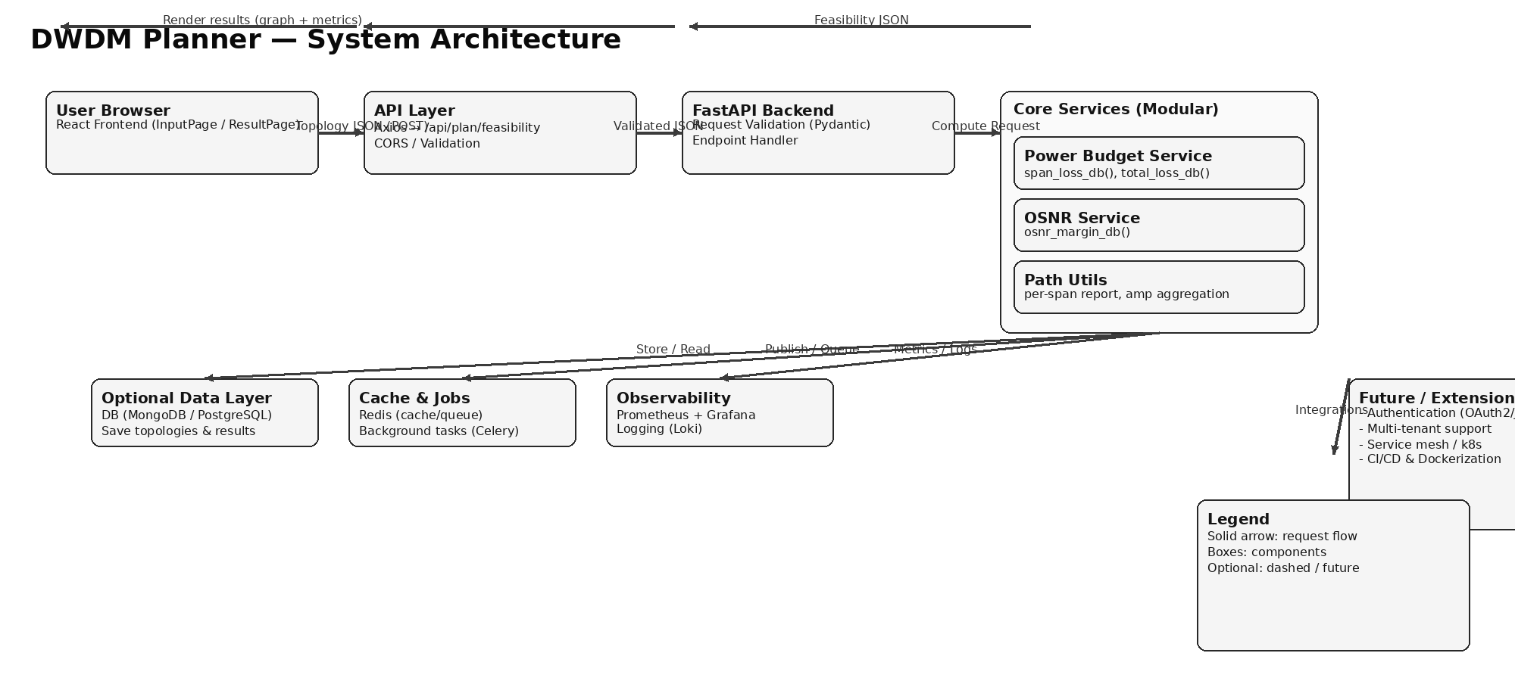
System Architecture

Slide 8
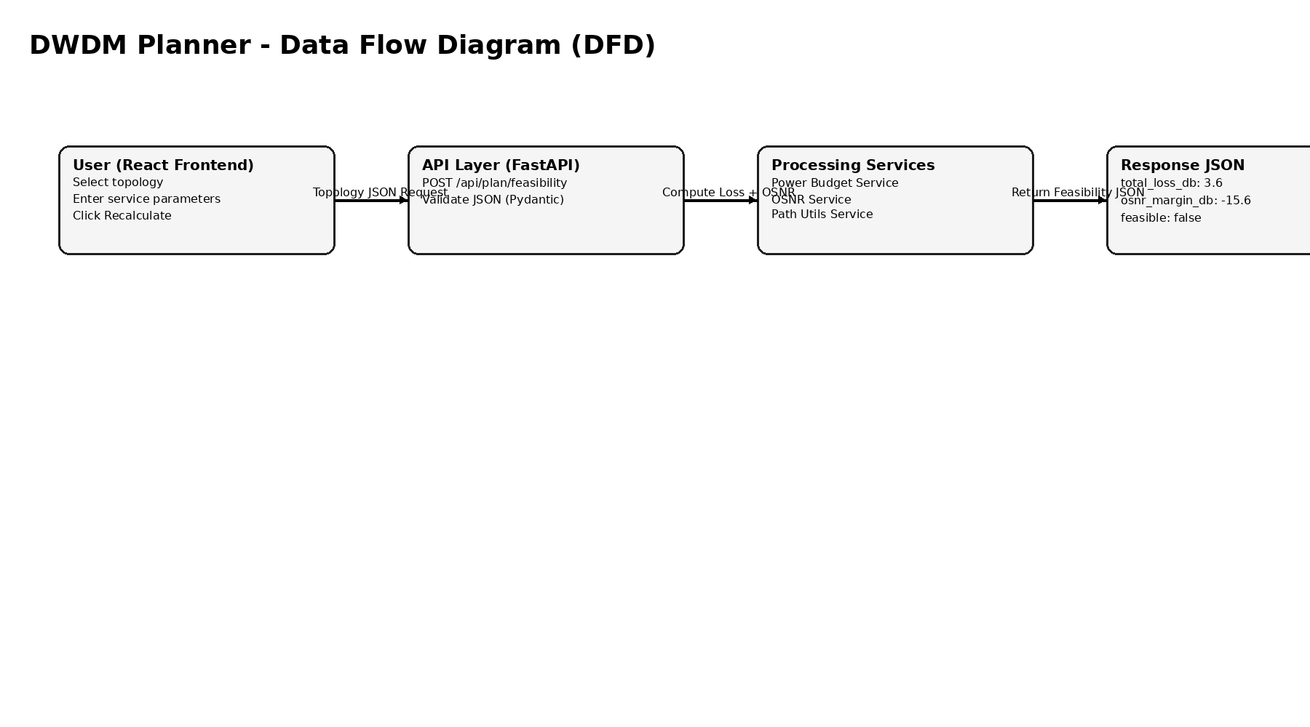
Data Flow Diagram

Slide 9
API Contract
Endpoint Information
HTTP Method: POST
URL : /api/plan/feasibility
Content-Type: application/json
Request Structure
{ "nodes": [ { "id": "A", "label": "Site A" }, { "id": "B", "label": "Site B" } ], "spans": [ { "from": "A", "to": "B", "length_km": 50, "connectors": 2, "splices": 6, "amplifier_gain_db": 10 } ], "service": { "tx_power_dbm": 0, "receiver_sensitivity_dbm": -26, "osnr_threshold_db": 18 }, "assumptions": { "fiber_atten_db_per_km": 0.22, "conn_loss_db": 0.5, "splice_loss_db": 0.1, "noise_penalty_db": 3.0, "amp_penalty_db": 1.0
}}
Response Structure
{ "total_loss_db": 3.6, "tx_power_dbm": -3.6, "osnr_margin_db": -15.6, "feasible": false, "per_span": [ { "span_index": 0, "from": "A", "to": "B", "length_km": 50, "loss_db": 3.6
} ],
"assumptions_used": { "fiber_atten_db_per_km": 0.22, "conn_loss_db": 0.5, "splice_loss_db": 0.1, "noise_penalty_db": 3.0, "amp_penalty_db": 1.0
}}

Slide 10
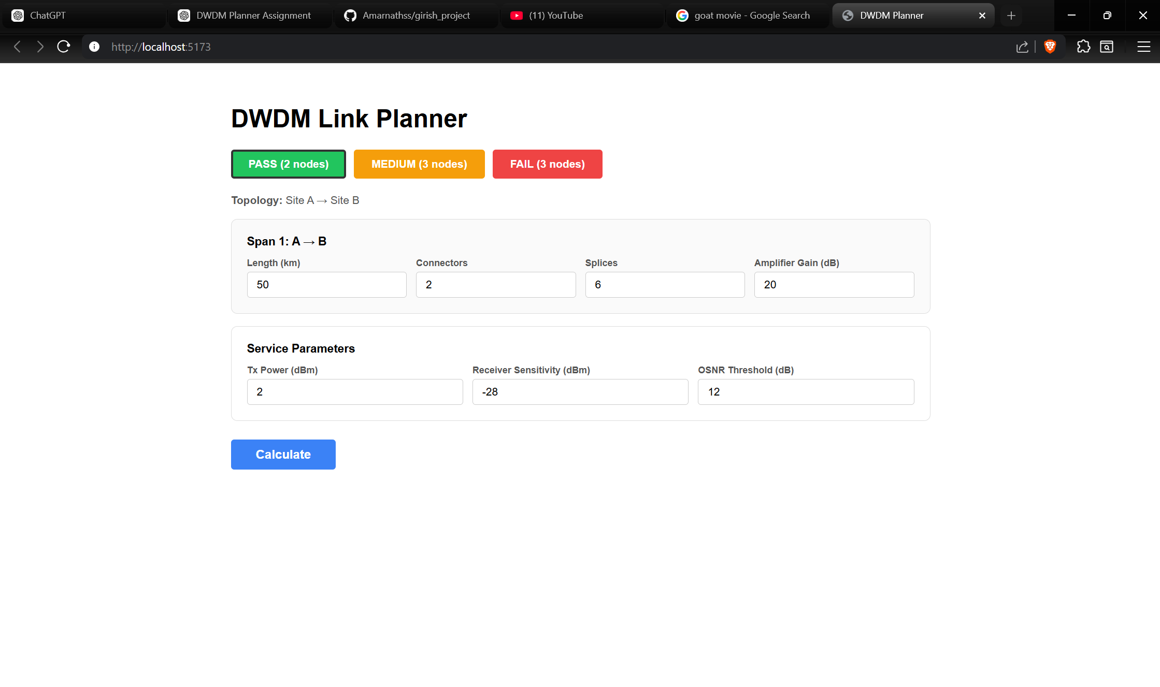
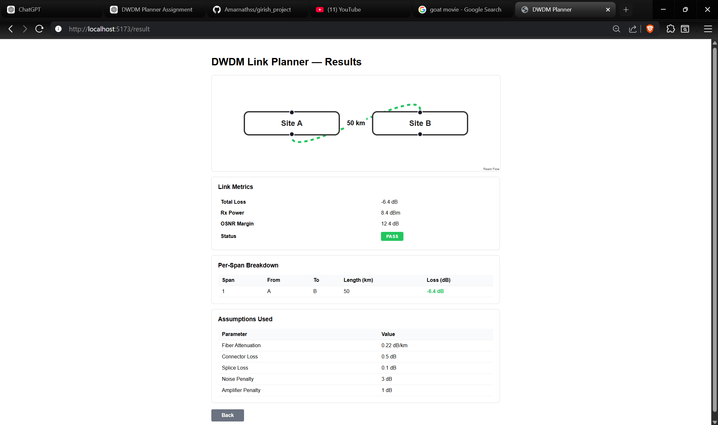
UI Screens

Slide 11
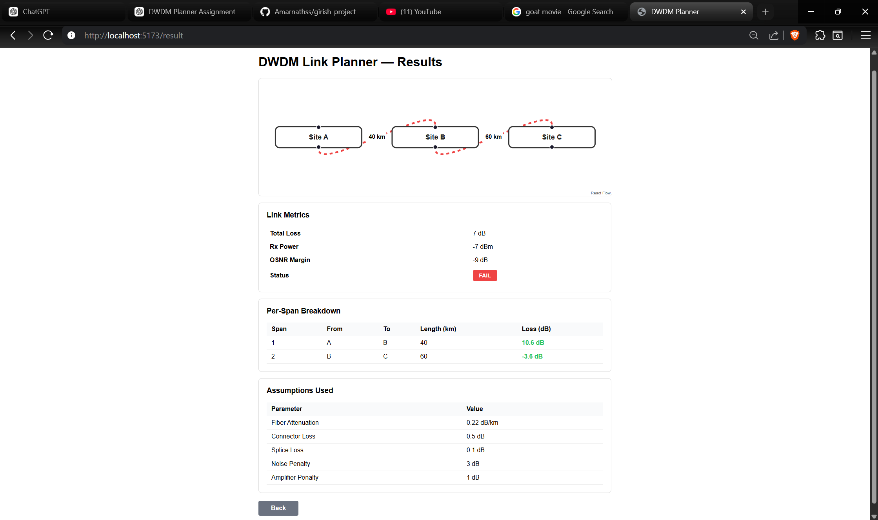
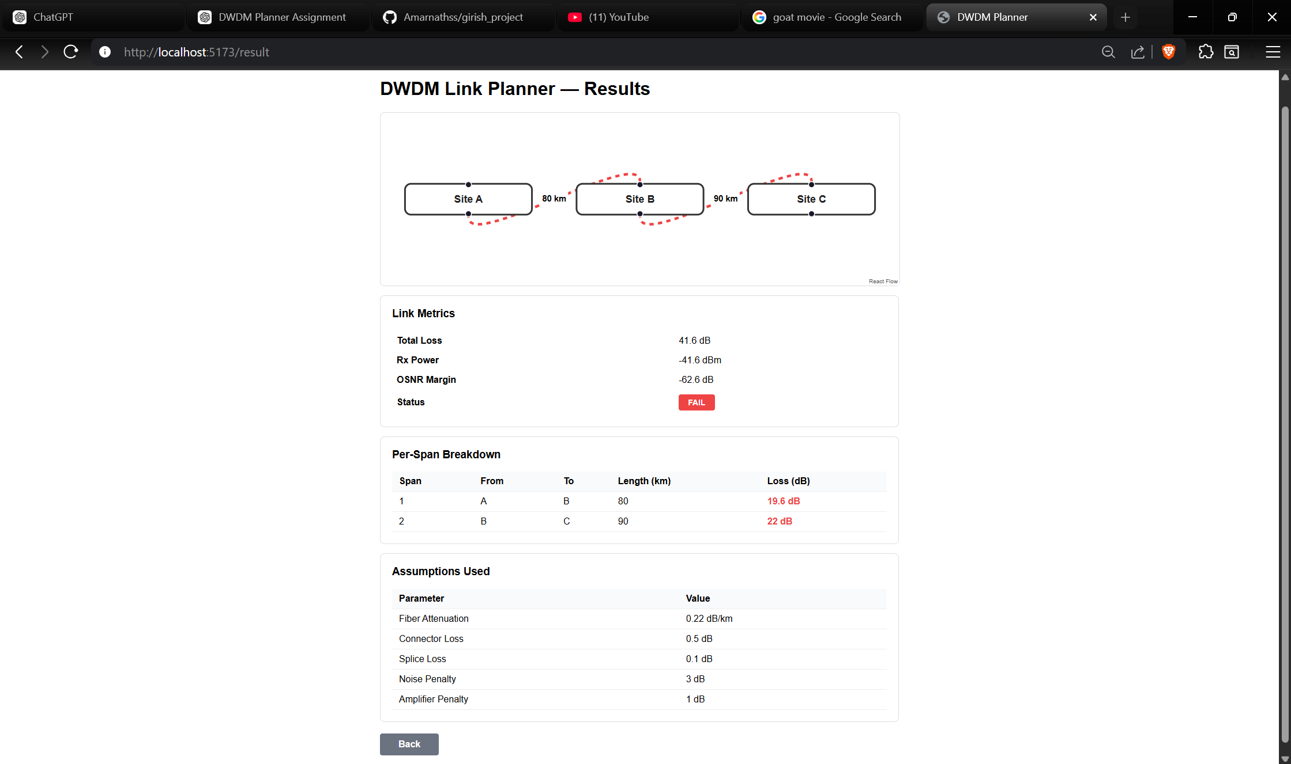
UI Screens

Slide 12
Edge Cases
The planner was tested against critical boundary conditions to ensure robustness.
• Long Spans
○ Large fiber length increases attenuation
○ Total loss may exceed power budget
○ Rx power may fall below sensitivity
• No Amplifiers
○ No gain to compensate fiber loss
○ High probability of power failure
○ Critical over long distances
• Receiver Sensitivity Limits
○ Rx power must exceed sensitivity
○ Even if OSNR is acceptable
○ Otherwise results in failure
• High OSNR Threshold
○ Advanced modulation needs higher OSNR
○ Stricter quality requirements
○ May fail despite sufficient power

Slide 13
Future Work
The current implementation is a simplified training model. Future enhancements can improve realism and scalability.
• Flex-Grid Support
○ Variable channel spacing
○ Flexible spectral allocation
○ Improved spectral efficiency
• Modulation-Aware Planning
○ Supports QPSK, 16QAM, etc.
○ Dynamic OSNR thresholds
○ Capacity-aware feasibility
• Regenerator (Regen) Planning
○ Identify regeneration locations
○ Support long-haul multi-span links
○ Improve signal quality
• Telemetry Integration
○ Use real-time performance data
○ Compare planned vs actual metrics
○ Enable adaptive optimization

Slide 14
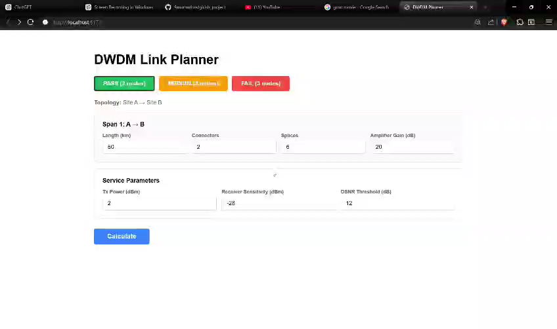
Demo

Slide 15
References
Basic DWDM Concepts (Training Notes)
FastAPI Documentation
React Documentation
Axios Documentation
React Flow Documentation

Slide 16
THANK YOU

